Slide 1
Encounters with the BRAVO Effect in Queueing Systems
Yoni Nazarathy
Swinburne University of Technology
Based on some joint papers with
Ahmad Al-Hanbali, Daryl Daley, Yoav Kerner,
Michel Mandjes, Gideon Weiss and Ward Whitt
University of Queensland Statistics Seminar
December 2, 2011

Slide 2
Outline
Queues and Networks
Variance of Outputs
BRAVO Effect
BRAVO Results (Theorems)
Summary

Slide 3
Queues and Networks

Slide 4
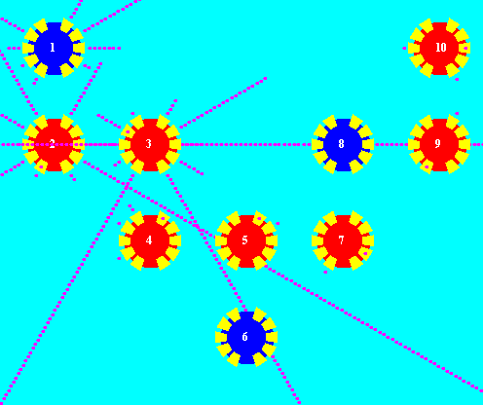
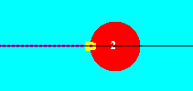
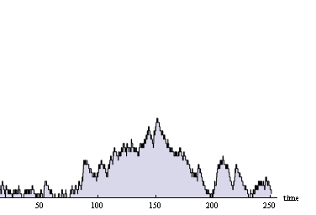

Slide 5
The GI/G/1/K Queue
Arrivals
Outputs
Overflows
Buffer:
Load:
Squared coefficients of variation:

Slide 6
Variance of Outputs

Slide 7
Variance of Outputs
Asymptotic Variance
Simple Examples:
* Stationary stable M/M/1, D(t) is PoissonProcess( ):
* Stationary M/M/1/1 with ,
D(t) is RenewalProcess(Erlang(2, )):
Notes:
* In general, for renewal process with :
* The output process of most queueing systems is NOT renewal

Slide 8
Asymptotic Variance when
After finite time, server busy forever…
is approximately the same as when or

Slide 9
Look now at the Asymptotic Variance
of M/M/1/K (for any Value of )

Slide 10
What values do we expect for ?
M/M/1/K
Similar to Poisson:

Slide 11
What values do we expect for ?
M/M/1/K

Slide 12
What values do we expect for ?
M/M/1/K
Balancing
Reduces
Asymptotic
Variance of
Outputs

Slide 13
Some Intuition…
…
0
1
K – 1
K

Slide 14
Do we Have the Same BRAVO Effect in M/M/1 ?

Slide 15
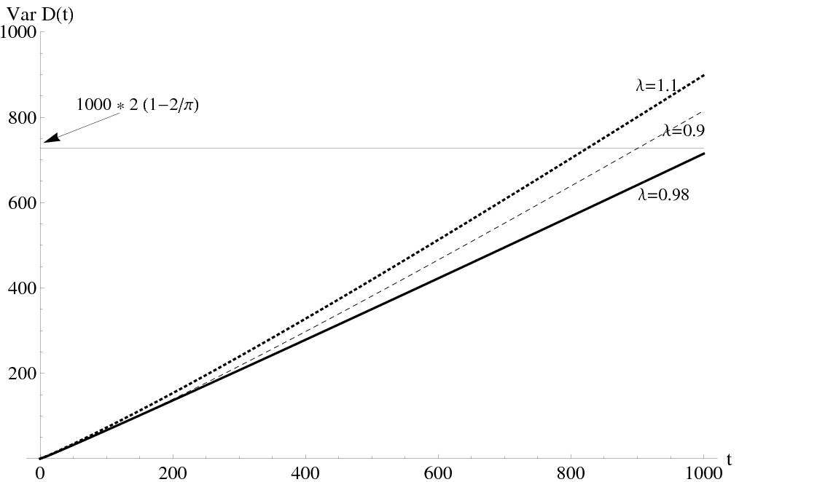
M/M/1 (Infinite Buffer)

Slide 16
Key BRAVO Results

Slide 17
Balancing Reduces Asymptotic Variance of Outputs
Theorem (N. , Weiss 2008):
For the M/M/1/K queue with :
Theorem (Al Hanbali, Mandjes, N. , Whitt 2010):
For the GI/G/1 queue with ,
under further conditions:
Conjecture (N. , 2011):
For the GI/G/1/K queue with :

Slide 18
A Bit More on the GI/G/1 Result

Slide 19
Reminder: Uniform Integrability (UI)
A family of RVs, , is UI if:
A sufficient condition is:
If (in distribution) and is UI then:

Slide 20
The GI/G/1 Result:
Theorem : Assume that is UI,
then , with
Theorem :
Theorem : Assume finite 4’th moments,
then, is UI under the following cases:
(i) Whenever and L(.) bounded slowly varying.
(ii) M/G/1
(iii) GI/NWU/1 (includes GI/M/1)
(iv) D/G/1 with services bounded away from 0

Slide 21
Summary
BRAVO:
Balancing Reduces Asymptotic Variance of Outputs
Different “BRAVO Constants”:
Finite Buffers:
Infinite Buffers:
Further probabilistic challenges in establishing full UI conditions
In future: Applications of BRAVO and related results in system identification (model selection)

Slide 22
BRAVO References
Yoni Nazarathy and Gideon Weiss, The asymptotic variance rate of the output process of finite capacity birth-death queues. Queueing Systems, 59, pp135-156, 2008.
Yoni Nazarathy, The variance of departure processes: Puzzling behavior and open problems. Queueing Systems, 68, pp 385-394, 2011.
Ahmad Al-Hanbali, Michel Mandjes, Yoni Nazarathy and Ward Whitt. The asymptotic variance of departures in critically loaded queues. Advances in Applied Probability, 43, 243-263, 2011.
Yonjiang Guo, Erjen Lefeber, Yoni Nazarathy, Gideon Weiss, Hanqin Zhang, Stability and performance for multi-class queueing networks with infinite virtual queues, submitted.
Daryl Daley, Yoni Nazarathy, The BRAVO effect for M/M/c/K+M systems, in preperation.
Yoni Nazarathy and Gideon Weiss, Diffusion Parameters of Flows in Stable Queueing Networks, in preparation.
Yoav Kerner and Yoni Nazarathy, On The Linear Asymptote of the M/G/1 Output Variance Curve, in preparation.

Slide 23
Extra Slides

Slide 24
MAP (Markovian Arrival Process)
Generator
Transitions without events
Transitions with events
Birth-Death Process
Asymptotic Variance Rate

Slide 25
Attempting to Evaluate Directly
For , there is a nice structure to the inverse.

Slide 26
Finite B-D Result
Scope: Finite, irreducible, stationary,
birth-death CTMC that represents a queue.
(Asymptotic Variance Rate of Output Process)
Part (i)
Part (ii)
Calculation of
If
and
Then

Slide 27
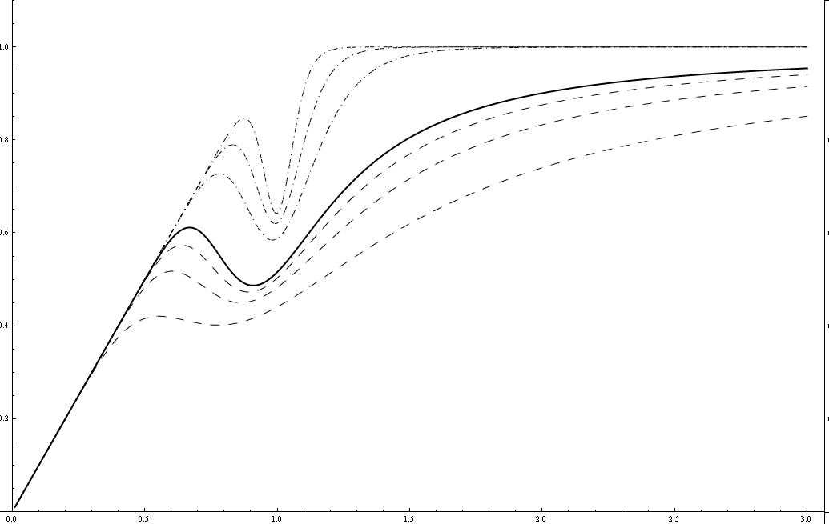
Other Systems
M/M/1/40
c=20
c=30
K=30
K=20
M/M/10/10
M/M/40/40

Slide 28
Using a Brownian Bridge
Theorem:
Proof Outline:
Brownian Bridge:

